Slide 1
Einstein and Brownian Motion or
How I spent My Spring Break
(not in Fort Lauderdale)
C. Jui
Undergraduate Seminar
March 25, 2004
I will make available this presentation at http://www.physics.utah.edu/~jui/brownian

Slide 2
Acknowledgments
My thanks to:
Sid Rudolph, the director of the ACCESS program, which is designed to integrate women into science, mathematics, and engineering careers.
Gernot Laicher, the director of Elementary Laboratory, who also prepared the micro-sphere suspension and took the video sequence of Brownian motion.

Slide 3
Acknowledgments (continued)
Also thanks to:
Lynn Monroe and Dr. Wilson of the Ken-A-vision Company who loaned us the T-1252 microscope which we used to make the measurement of Avogadro’s Number from Brownian Motion

Slide 4
Outline
What is Brownian Motion
The phenomenon 1827-1000
Einstein’s paper of 1905
Langevin’s Complete Derivation
My Science Fair Project (How I spent my Spring Break)
Epilogue

Slide 5
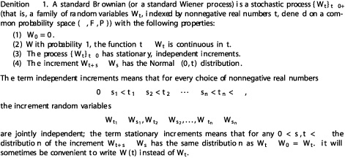
What is Brownian Motion?
#1 answer from Google (Dept. of Statistics)
http://galton.uchicago.edu/~lalley/Courses/313/WienerProcess.pdf

Slide 6
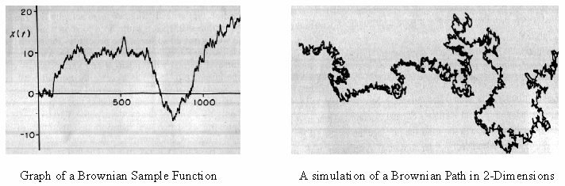
Other answers
From computer Science at Worcester Polytechnic Inst.
http://davis.wpi.edu/~matt/courses/fractals/brownian.html Brownian Motion is a line that will jump up and down a random amount and simular to the "How Long is the Coast of Britain?" problem as you zoom in on the function you will discover similar patterns to the larger function.
The two images above are examples of Brownian Motion. The first being a function over time. Where as t increases the function jumps up or down a varying degree. The second is the result of applying Brownian Motion to the xy-plane. You simply replace the values in random line that moves around the page.

Slide 7
Electrical Engineering
A less commonly referred to 'color' of noise is 'brown noise'. This is supposed simulate Brownian motion a kind of random motion that shifts in steady increments. 'Brown noise' decreases in power by 6 dB per octave.

Slide 8
The source of Confusion
There are two meanings of the term Brownian motion:
  the physical phenomenon that minute particles immersed/suspended in a fluid will experience a random movement
  the mathematical models used to describe the physical phenomenon.
Quite frequently people fail to make this distinction

Slide 9
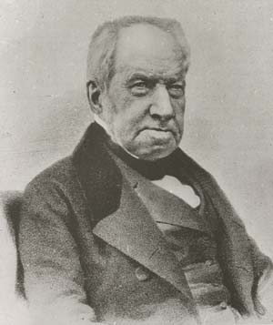
Brownian Motion: Discovery
Discovered by Scottish botanist Robert Brown in 1827 while studying pollens of Clarkia (primrose family) under his microscope

Slide 10
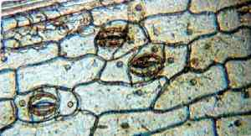
Robert Brown
Robert Brown’s main claim to fame is his discovery of the cell nucleus when looking at cells from orchids under his microscope
20 orchid epidermal cells showing nuclei (and 3 stomata) seen under Brown’s original microscope preserved by the Linnean Society London

Slide 11
Controversy even in 1991
In 1991 there was some controversy concerning whether or not Brown could have seen Brownian motion:
  Deutsch D. H. “Did Robert Brown observe Brownian Motion: probably not”. Bulletin of the American Physical Society 36 (4): 1374 April 1991. Reported in Scientific American 265: 20 1991.

Slide 12
Reprise of Brown’s Experiment
A reprise of Brown’s observations with Clarkia pollen was performed using the original microscope in Chicago in 1992.
A video demonstration showed clear demonstration of Brownian motion

Slide 13
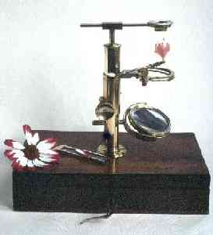

Brown’s Microscope
And Brownian motion of milk globules in water seen under Robert Brown’s microscope

Slide 14
Brown’s Observations
At first Brown suspected that he might have been seeing locomotion of pollen grains (I.e. they move because they are alive)
Brown then observed the same random motion for inorganic particles…thereby showing that the motion is physical in origin and not biological.
Word of caution for the Mars Exploration program: Lesson to be learned here from Brown’s careful experimentation.

Slide 15
1827-1900
Desaulx (1877):
  "In my way of thinking the phenomenon is a result of thermal molecular motion (of the particles) in the liquid environment”
G.L. Gouy (1889):
  observed that the "Brownian" movement appeared more rapid for smaller particles

Slide 16
F. M. Exner (1900)
F.M. Exner (1900)
  First to make quantitative studies of the dependence of Brownian motion on particle size and temperature
  Confirmed Gouy’s observation of increased motion for smaller particles
  Also observed increased motion at elevated temperatures

Slide 17
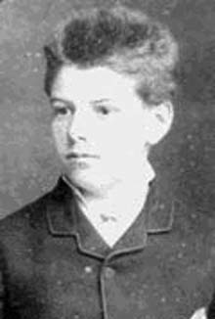
Louis Bachelier (1870-1946)
Ph.D Thesis (1900): "Théorie de la Spéculation" Annales de l'Ecole normale superiure
Inspired by Brownian motion he introduced the idea of “random-walk” to model the price of what is now called a barrier option (an option which depends on whether the share price crosses a barrier).

Slide 18
Louis Bachelier (continued)
The “random-walk” model is formally known as “Wiener (stochastic) process” and often referred to as “Brownian Motion”
This work foreshadowed the famous 1973 paper: Black F and Scholes M (1973) “The Pricing of Options and Corporate Liabilities” Journal of Political Economy 81 637-59
Bachelier is acknowledged (after 1960) as the inventor of Mathematical Finance (and specifically of Option Pricing Theory)

Slide 19

Black and Scholes
Myron Scholes shared the 1997 Nobel Prize in economics with Robert Merton
  New Method for Calculating the prize ofderivatives
Fischer Black died in 1995

Slide 20
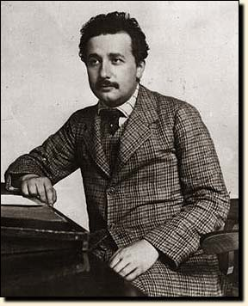
Albert Einstein
Worked out a quantitative description of Brownian motion based on the Molecular-Kinetic Theory of Heat
Published as the third of 3 famous three 1905 papers
Awarded the Nobel Prize in 1921 in part for this.

Slide 21
Einstein’s 1905 papers
On a Heuristic Point of View on the Creation and Conversion of Light (Photo-Electric Effect)
  http://lorentz.phl.jhu.edu/AnnusMirabilis/AeReserveArticles/eins_lq.pdf
On the Electrodynamics of Moving Bodies (Theory of Special Relativity)
  http://www.fourmilab.ch/etexts/einstein/specrel/www/
Investigation on the Theory of the Brownian Movement
  http://lorentz.phl.jhu.edu/AnnusMirabilis/AeReserveArticles/eins_brownian.pdf

Slide 22
Historical Context
Einstein’s analysis of Brownian Motion and the subsequent experimental verification by Jean Perrin provided 1st “smoking gun” evidence for the Molecular-Kinetic Theory of Heat
Kinetic Theory is highly controversial around 1900…scene of epic battles between its proponents and its detractors

Slide 23
Molecular-Kinetic Theory
All matter are made of molecules (or atoms)
Gases are made of freely moving molecules
U (internal energy) = mechanical energy of the individual molecules
Average internal energy of any system: ⟨U⟩=nkT/2, n = no. of degrees of freedom
Boltzmann: Entropy S=klogW where W=no. of microscopic states corresponding to a given macroscopic state

Slide 24
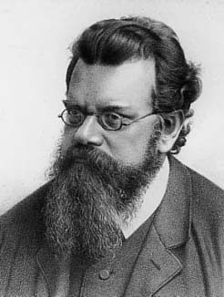
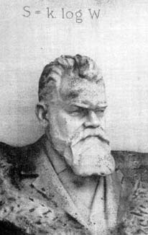
Ludwig Boltzmann (1844-1906)
Committed suicide in 1906. Some think this was because of the vicious attacks he received from the Scientific Establishment of the Day for his advocacy of Kinetic Theory
Boltzmann’s tombstone
in Vienna

Slide 25
Einstein’s Paper
In hindsight Einstein’s paper of 1905 on Brownian Motion takes a more circuitous route than necessary.
He opted for physical arguments instead of mathematical solutions
I will give you the highlights of the paper rather than the full derivations
We will come back to a full but shorter derivation of Paul Langevin (1908)

Slide 26
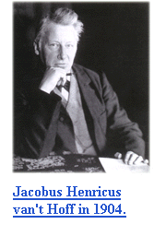
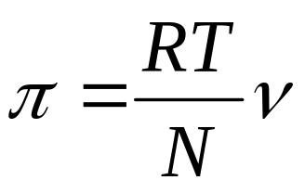
Section 1: Osmotic Pressure
Einstein reviews the Law of Osmotic Pressure discovered by J. van’t Hoff who won the Nobel Prize in Chemistry for this in 1901
In a dilute solution:
π = osmotic pressure
ν = solute concentration
N = Avogadro’s number
R = gas constant
T = absolute temperature

Slide 27

Osmotic Pressure

Slide 28
Section 1 (continued)
Einstein also argues that from the point of view of the Kinetic Theory the Law of Osmotic Pressure should apply equally to suspension of small particles

Slide 29
Section 2
Einstein derives the Law of Osmotic Pressure as a natural consequence of Statistical Mechanics
  The law minimizes the Helmholtz Free Energy with entropy calculated following Boltzmann’s prescription

Slide 30
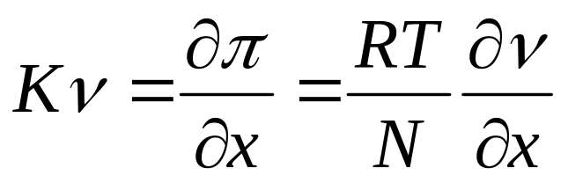
Section 3: Diffusion
Using Statistical Mechanics (minimizing free energy) Einstein shows that a particle (in suspension) in a concentration gradient (in x) will experience a force K given (in magnitude) by
This force will start a flow of particles against the gradient.

Slide 31
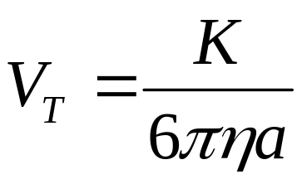
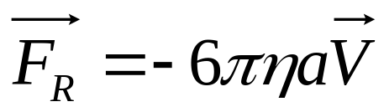
Diffusion (continued)
Assuming a steady state flow (in a constant gradient and in a viscous medium) the particles will reach terminal velocity of
Here π = 3.1415.. η = viscosity of fluid medium
a = radius of spherical particles executing Stokes flow and experiencing a resistive force of

Slide 32
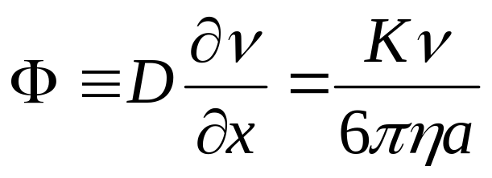
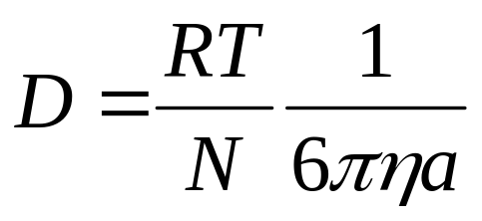
Diffusion (continued)
The resulting flux of particles is then given by
Resulting in a definite prediction for the diffusion constant D given by
This result a prediction of Kinetic Theory can be checked experimentally in Brownian Motion!

Slide 33
Section 4: Random Walk
Einstein then analyzes the Brownian Motion of particles suspended in water as a 1-d random walk process.
Unaware of the work of Bachelier his version of random walk was very elementary
He was able to show with his own analysis that this random walk problem is identical to the 1-d diffusion problem

Slide 34
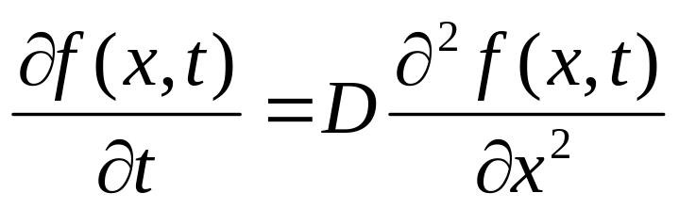
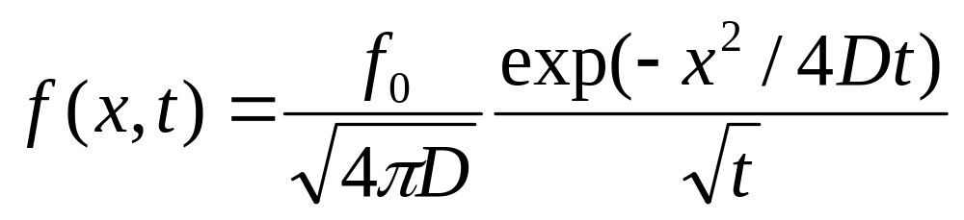
Random Walk (continued)
The 1-d diffusion equation is
This equation has the Green’s Function (integral kernel) given by
Which is then the expected concentration of particles as a function of time where all started from the origin.

Slide 35
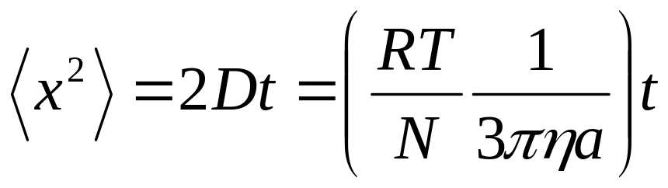
Section 5: Average x²
Taking the initial position of each particle to be its origin then the average x² is then given by
Einstein finishes the paper by suggesting that this diffusion constant D can be measured by following the motion of small spheres under a microscope
From the diffusion constant and the known quantities R η and a one can determine Avogadro’s number N

Slide 36
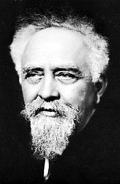
Jean Perrin (1870-1942)
Using ultra-microscope Jean Perrin began quantitative studies of Brownian motion in 1908
Experimentally verified Einstein’s equation for Brownian Motion
Measured Avogadro’s number to be N = 6.5-6.9x10²³
From related work he was the first to estimated the size of water molecules
Awarded Nobel Prize in 1926

Slide 37
Ultra-Microscope
From The Encyclopedia Britannica
microscope arrangement used to study colloidal-size particles that are too small to be visible in an ordinary light microscope. The particles usually suspended in a liquid are illuminated with a strong light beam perpendicular to the optical axis of the microscope. These particles scatter light and their movements are seen only as flashes against a dark background

Slide 38
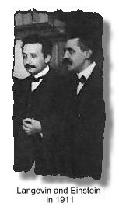
Paul Langevin (1872-1946)
Most known for:
  Developed the statistical mechanics treatment of paramagnetism
  work on neutron moderation contributing to the success to the first nuclear reactor
The Langevin Equation and the techniques for solving such problems is widely used in econometrics

Slide 39
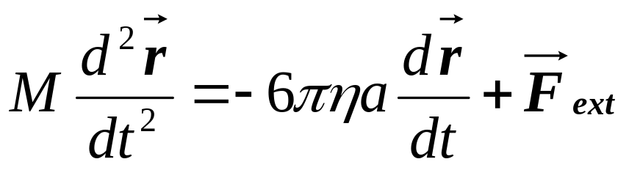
Langevin Equation
In 1908 Paul Langevin developed a more direct derivation based on a stochastic (differential) equation of motion. We start with Newton’s 2nd Law (Langevin Equation):
η = viscosity of water
F_{ext} is a “random” force on the particle

Slide 40
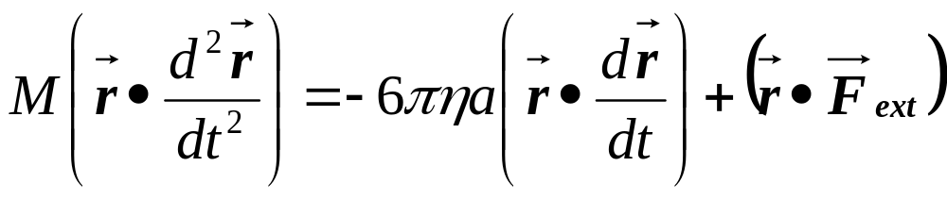
Scalar product by r
We now take the dot (scalar product) of the equation of motion by r :
Next we re-express the above equation in terms of r² instead.

Slide 41
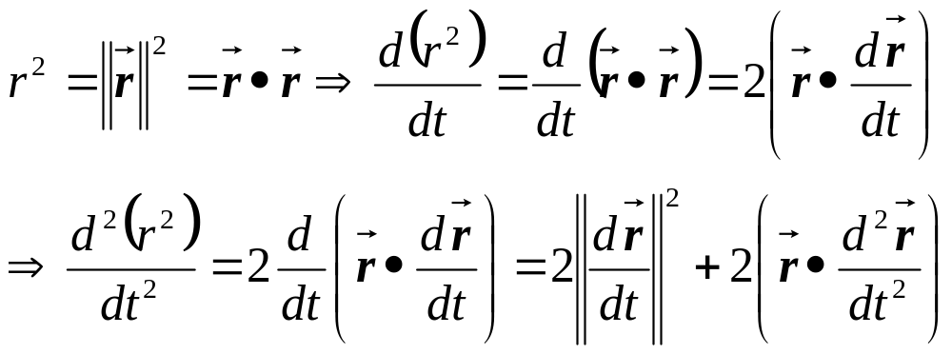
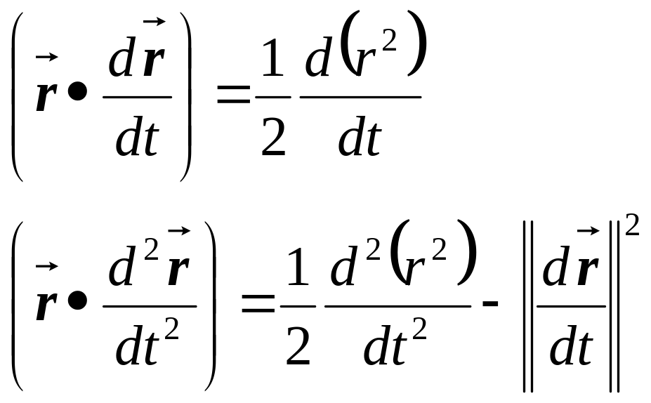
Change of Variable to r²

Slide 42
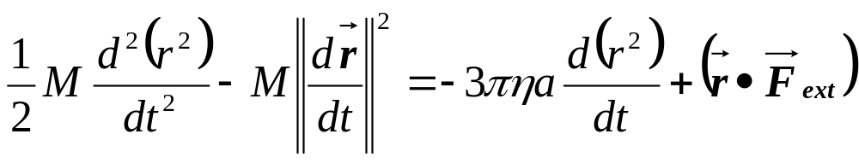
Ensemble Average
The equation of motion now becomes:
Rearranging the equation and denoting ||dr/dt||²=V²
Next we take the average over a large number of particles (“ensemble average” denoted by ⟨ ⟩ ) and using u ≡ ⟨r²⟩

Slide 43
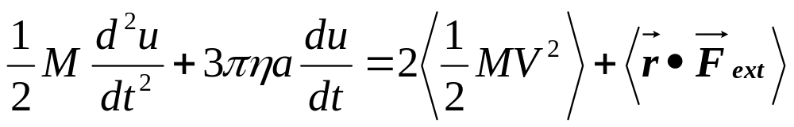
The Physics!!!
0
The last term on the right vanishes because F_{ext} is a “random” force not correlated with the position of the particle.
By Equi-partition Theorem we have ⟨½MV²⟩ = nkT/2 (a constant!) where n is the number of spatial dimensions involved and k is again the Boltzmann Constant.
PHYSICS!!!

Slide 44
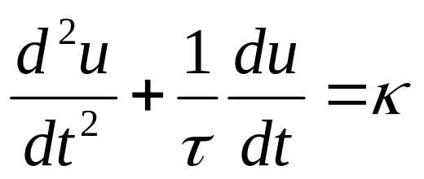
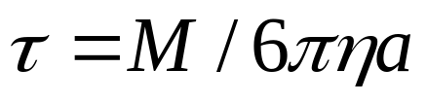
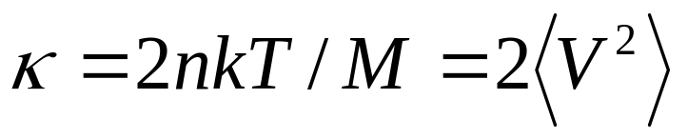
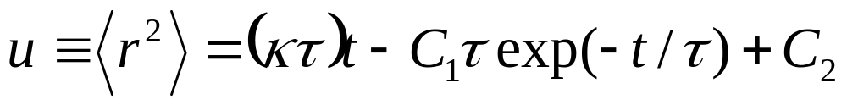
Solving the Differential Equation
⇒ A 2nd order linear inhomogenous ODE:
where
and
Using MAPLE to solve this :

Slide 45
Initial Conditions
⟨r²⟩ = 0 at t = 0
  Assuming initial position of each particle to be its origin.
d⟨r²⟩/dt = 0 at t = 0
  At very small t (I.e. before any subsequent collisions) we have r_{i}² = (V_{i}t)² where V_{i} is the velocity the i^{th} particle inherited from a previous collision.
  ⇒ ⟨r²⟩ = ⟨V²⟩ t² ⇒ d⟨r²⟩/dt |_{t=0} = 0

Slide 46
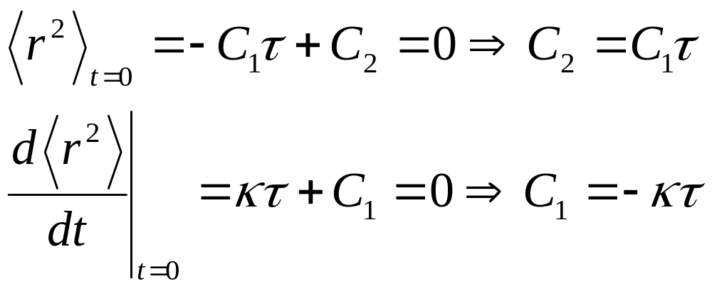
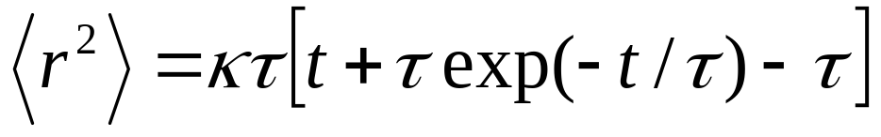
Applying Initial Conditions
We arrive at the solution

Slide 47
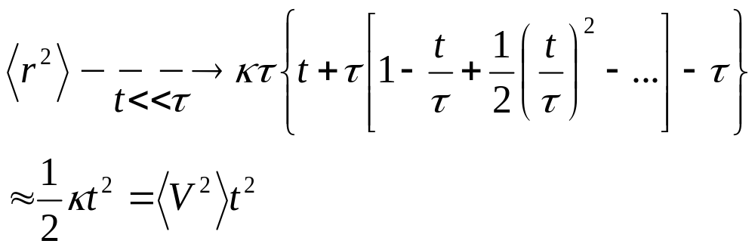
Langevin: t << τ case
Expanding the exponential in Taylor series to 2nd order in t. Note 0th and 1st order terms cancel with the two other terms.

Slide 48
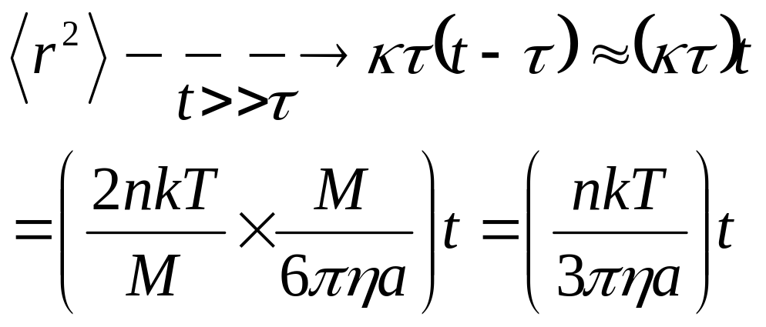
Langevin: t >> τ case
Taking the other extreme which is the case of interest
Which is the same as Einstein’s result but with an extra factor of n (Note Einstein’s derivations were for a 1-d problem)

Slide 49
My Science Fair Project
(How I Spent my Spring Break)
We are setting up a Brownian motion experiment for UGS 1430 (ACCESS summer program) and for PHYCS 2019/2029
Will use inexpensive Digital microscopes with a 100X objective
Use 1 μm diameter (3% uniformity) polystyrene
Did a “fun” run using an even cheaper digital scope with a 40X objective

Slide 50
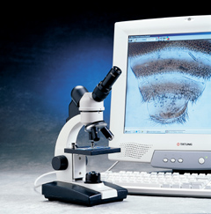
The Tool
Used a Ken-A-Vision T-1252 Digital Microscope loaned to us by the company
Up to 40X objectve
USB interface for video capture

Slide 51

1 fps time-lapse movie (March 17, 2004)

Slide 52
Data Analysis
t(s) x y
0 238 414
10 246 402
20 247 396
30 246 397
40 250 405
50 238 403
60 228 414
70 227 400
80 225 397
90 241 409
100 234 408
110 236 408
120 238 410
Followed 14 particles for 80 seconds
digitized x and y position every 10 seconds using Free package “DataPoint”
http://www.stchas.edu/faculty/gcarlson/physics/datapoint.htm
Raw data for particle #9 shown to the right (x, y coordinates in pixels)

Slide 53
Data Analysis (continued)
Some “bulk flow” was observed: ⟨x⟩ and ⟨y⟩ were non-zero and changed steadily with time. For pure Brownian motion these should be constant AND zero
To account for the flow we used σ_{x}²=⟨x²⟩-⟨x⟩² and σ_{y}²= ⟨y²⟩-⟨y⟩² instead of just ⟨x²⟩ and ⟨y²⟩ in the analysis

Slide 54
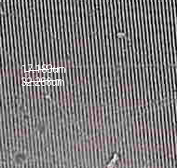
Microscope Calibration
Calibrated the microscope by observing a glass grating with 600 lines per miliimeter
0.42 μm per pixel

Slide 55
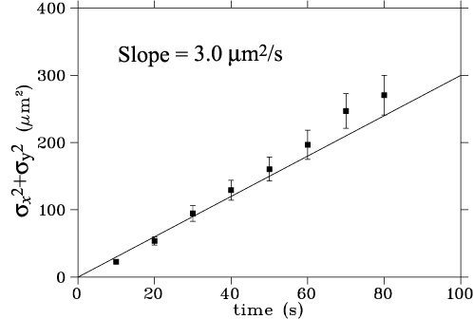
The answer
Assuming 70F temp (and associated viscosity) we get N_{A}= 5.1x10²³

Slide 56
Epilogue
Brownian motion is a topic that touches many different disciplines
Einstein’s contribution was to use Brownian motion as a vehicle to prove the Molecular-Kinetic Theory of Heat
  Often misunderstood by non-physicists
Brownian motion can be investigated experimentally for less than $500!!!

